Slide 1
Week 3
Adding an INDEX to speed up the finding of records.

Slide 2
Student Objectives
Upon completion of this video, you should be able to:
Define the following types of indices: Primary, Clustered, Secondary, Dense and Sparse
Determine at which times you would use each of the types of indices above
Differentiate between a single level index and a multi level index
Given a number of records, record size and block size, figure out the average number of searches needed to find a record and the worst case scenario for searching for a given record that has a single level index associated with it.

Slide 3
WHAT ELSE COULD WE do to speed up searches?
QUESTION: if you are looking for something in a large PAPER text book, what do you do?
ANSWER: use the index!

Slide 4
Index
More versatile than hashing (can use on a range of values or part of a key)
Records are stored in one file and the index(es) is stored in another file, stored in the disk.
Load up the index first (hopefully the index can fit all in one block and can load the entire index into Main Memory).
We then search the index file for the field (attribute) we are looking for and it tells us where to find the block that holds the complete item (record) associated with that field
Types of Single-level Ordered Indexes
Primary
Clustered
Secondary

Slide 5
Index
More versatile than hashing (can use on a range of values or part of a key)
Records are stored in one file and the index(es) is stored in another file, stored in the disk.
Load up the index first (hopefully the index can fit all in one block and can load the entire index into Main Memory).
We then search the index file for the field (attribute) we are looking for and it tells us where to find the block that holds the complete item (record) associated with that field
Types of Single-level Ordered Indexes
Primary
Clustered
Secondary

Slide 6
What does the index look like?
Usually of the form: <field value , pointer to record> e.g. 250012345, pointer to block 45
Sample Index File:
250012345, block 45
250012347, block 23
250012350, block 45
250999998, block 71

Slide 7
More terminology
Dense index has an index entry for every search key value
Sparse (non-dense) index has index entry for only some of the search values
Dense Index:
Data File | Page (Block)
All of SA9 Record | 1
All of SG5 Record
All of SG14 Record | 2
All of SG37 Record
All of SL21 Record | 3
All of SL41 Record
Index File
SA9 | 1
SG5 | 1
SG14 | 2
SG37 | 2
SL21 | 3
SL41 | 3

Slide 8
Sparse Index:
Data File | Page (Block)
All of SA9 Record | 1
All of SG5 Record
All of SG14 Record | 2
All of SG37 Record
All of SL21 Record | 3
All of SL41 Record
Index File
SA9 | 1
SG14 | 2
SL21 | 3

Slide 9
Primary Index
Always defined on an ordered data file
Ordered on the ordering key field (but might not be the primary key of the table)
Includes one index entry for EACH BLOCK in the data file (not for each record)

Slide 10
Primary Index
Always defined on an ordered data file
Ordered on the ordering key field (but might not be the primary key of the table)
Includes one index entry for EACH BLOCK in the data file (not for each record)

Slide 11
Clustering Index
Defined on an ordered data file
Ordered on a non key field, thus every ordering field might not be distinct
Includes one index entry for each distinct value in the ordering field
Insertions and deletions are straightforward if each cluster starts a new block

Slide 12
Clustering Index
Defined on an ordered data file
Ordered on a non key field, thus every ordering field might not be distinct
Includes one index entry for each distinct value in the ordering field
Insertions and deletions are straightforward if each cluster starts a new block

Slide 13
Secondary Index
Provides a secondary access for a file which already has primary access
Might be on a candidate key or any field
Can have many secondary indexes
Includes one entry for each record, hence it is DENSE

Slide 14
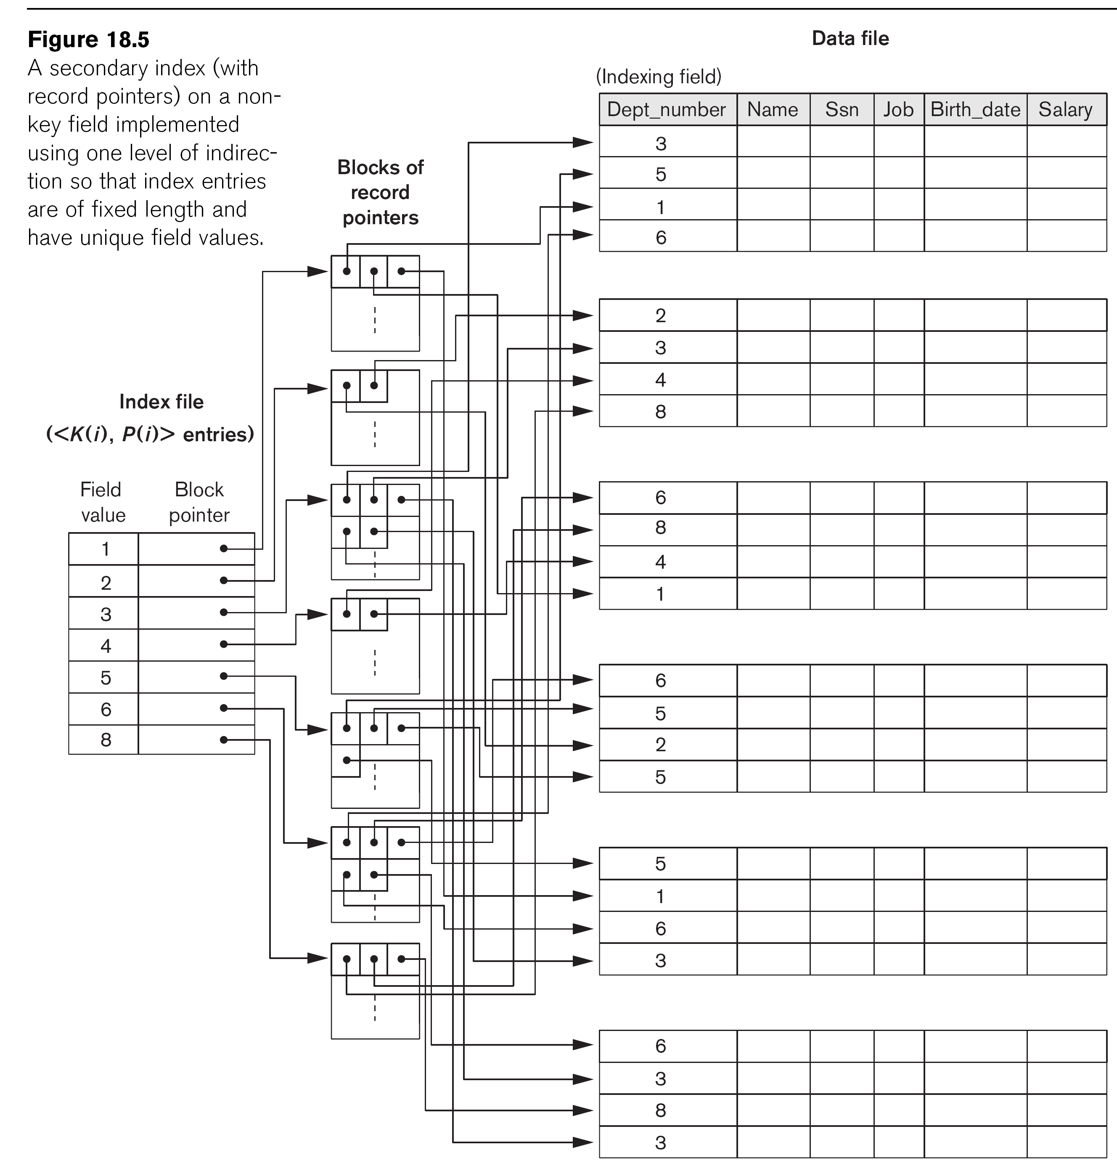
Secondary Index
Provides a secondary access for a file which already has primary access
Might be on a candidate key or any field
Can have many secondary indexes
Includes one entry for each record, hence it is DENSE

Slide 15
Example
Index file which is 834 blocks long
Actual data on the disk which is 25000 blocks long
QUESTION: Find the worst case search time to find a record if you use a binary search on an dense (one entry for each record) index the following scenario:
We have100,000 records stored on a disk with block size B = 2048 bytes.
Records are fixed size of R = 500 bytes.
Ordering key field is K = 10 bytes, a block pointer P = 7 bytes, thus size of the primary index record is _________ bytes per record
Blocking Factor for the index file = 2048/17
Thus we can hold ______ key fields and block pointers on 1 block
# of blocks needed for the index is ________________ = _______ blocks
Binary Search would need approximately log2b = log₂ ______= ____ block accesses + 1 to get to the data = ___ block accesses
17
120
100,000/120
834
834
10
11
Notes:
17
records per block for the primary index
100000/120 → need 834 blocks to hold all the keys and the pointers
Log 2 of 834 → 9.7
10+ 1 block accesses = 11

Slide 16
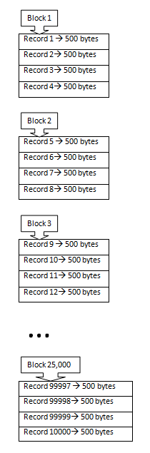
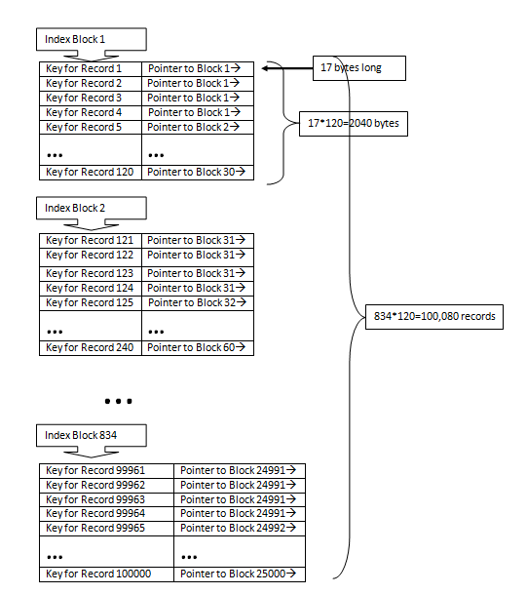
Example
Index file which is 834 blocks long
Actual data on the disk which is 25000 blocks long
QUESTION: Find the worst case search time to find a record if you use a binary search on an dense (one entry for each record) index the following scenario:
We have100,000 records stored on a disk with block size B = 2048 bytes.
Records are fixed size of R = 500 bytes.
Ordering key field is K = 10 bytes, a block pointer P = 7 bytes, thus size of the primary index record is _________ bytes per record
Blocking Factor for the index file = 2048/17
Thus we can hold ______ key fields and block pointers on 1 block
# of blocks needed for the index is ________________ = _______ blocks
Binary Search would need approximately log2b = log₂ ______= ____ block accesses + 1 to get to the data = ___ block accesses
17
120
100,000/120
834
834
10
11
Notes:
17
records per block for the primary index
100000/120 → need 834 blocks to hold all the keys and the pointers
Log 2 of 834 → 9.7
10+ 1 block accesses = 11

Slide 17
QUESTION: Find the worst case search time to find a record if you use a binary search on an sparse (one entry for each BLOCK not each record) index the following scenario:
We have 100,000 records stored on a disk with block size B = 2048 bytes.
Records are fixed size of R = 500 bytes.
Blocking Factor for the records = 2048 / 500 = __________
Number of blocks needed to hold the records = ____________
Ordering key field is K = 10 bytes, a block pointer P = 7 bytes, thus size of the primary record is _________ bytes per record
Blocking Factor for index = 2048 /17 = ________
Total number of entries in the index = total number of blocks= ____________
# of blocks needed for the index is = total number of blocks / Blocking Factor for Index = _______________ = _______ blocks
Binary Search would need approximately log₂b = log₂ _______= ____ block accesses + 1 to get to the data = ___ block accesses
Index file which is 209 blocks long
Actual data on the disk which is 25000 blocks long
4
25000
17
120
25000
25000/120
209
209 8
9
Notes:
25000 blocks needed
17 bytes per record
120 pointer per block
25000/120 = 209
8 access
8+1 = 9 block accesses

Slide 18
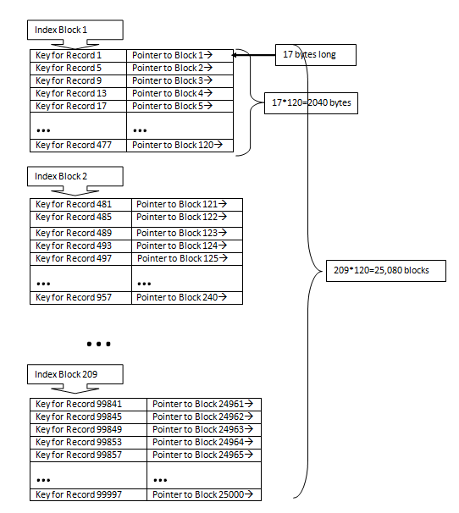
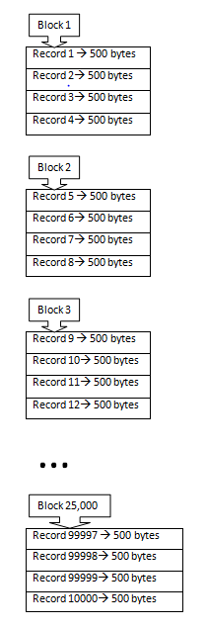
QUESTION: Find the worst case search time to find a record if you use a binary search on an sparse (one entry for each BLOCK not each record) index the following scenario:
We have 100,000 records stored on a disk with block size B = 2048 bytes.
Records are fixed size of R = 500 bytes.
Blocking Factor for the records = 2048 / 500 = __________
Number of blocks needed to hold the records = ____________
Ordering key field is K = 10 bytes, a block pointer P = 7 bytes, thus size of the primary record is _________ bytes per record
Blocking Factor for index = 2048 /17 = ________
Total number of entries in the index = total number of blocks= ____________
# of blocks needed for the index is = total number of blocks / Blocking Factor for Index = _______________ = _______ blocks
Binary Search would need approximately log₂b = log₂ _______= ____ block accesses + 1 to get to the data = ___ block accesses
Index file which is 209 blocks long
Actual data on the disk which is 25000 blocks long
4
25000
17
120
25000
25000/120
209
209 8
9
Notes:
25000 blocks needed
17 bytes per record
120 pointer per block
25000/120 = 209
8 access
8+1 = 9 block accesses

